Slide 1


Walmart Stores Sales Prediction
Submitted By:
Dipak Pawar
Guide:
Mr. Akshay Tilekar

Slide 2
Index
Project Overview
Problem Statement
Algorithms Used
Tools Used
Methodology
Flow Diagram
Future Work & Conclusion

Slide 3
Project Overview
Walmart is a renowned retail corporation that operates a chain of hypermarkets. Here, Walmart has provided a data combining of 45 stores including store information and monthly sales. The data is provided on weekly basis. Walmart tries to find the impact of holidays on the sales of store. For which it has included four holidays weeks into the dataset which are Christmas, Thanksgiving, Super bowl, Labor day. Here we are owing to Analyze the dataset given. before doing that , let me point out the objective of this analysis. Our Main Objective is to predict sales of store in a week.

Slide 4
Problem Statement
The problem is quite straightforward. Data from Walmart stores accross the US is given, and it is up to us to forecast their weekly sales. The data is already split into a training and a test set, and we want to fit a model to the training data that is able to forecast those weeks sales as accurately as possible. In fact, our metric of interest will be the Mean Absolute Error and R2 score value.The metric is not very complicated. The further away from the actual outcome our forecast is, the harder it will be punished. Optimally, we exactly predict the weekly sales. This of course is highly unlikely, but we must try to get as close as possible

Slide 5
ML Algorithms used :
Linear Regression
Ridge Regression
Lasso Regression
Decision Tree
Random Forest
XGBoost

Slide 6
Tools Used
Python
Google collab
Power Bi
Flask
HTML
PYCHARM
AWS

Slide 7
Methodology
The objective of this project is to predict the weekly sales of walmart in US. The data set is contained from Kaggle and has 3 csv files namely features, stores and train. The data is merged to obtain one master datafile and then the data preprocessing is carried out.
After EDA process the model is built and successfully tested.
Loading the Raw Data
Exploratory Data Analysis
Model Building

Slide 8
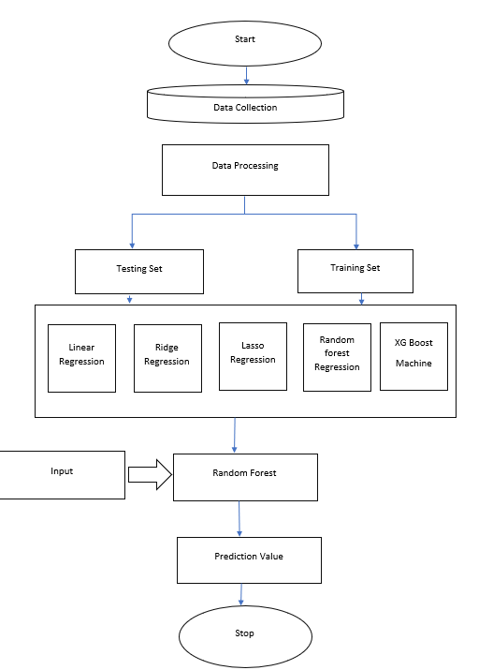
Flow Diagram:

Slide 9
Future Work & Conclusion :
Future Work:
The objective of this project is to predict the weekly sales of walmart in US. The data set is contained from Kaggle and has 3 csv files namely features, stores and train. The data is merged to obtain one master datafile and then the data preprocessing is carried out.
After EDA process the model is built and successfully tested.

Slide 10
Conclusion:
Type 'A' stores are more popular than 'B' and 'C' types
Type 'A' stores outclass the 'B' and 'C' types in terms of size and the average weekly sales
Weekly Sales are effected by the week of year. Holiday weeks witnessed more sales than the non-holiday weeks. Notables are Thanksgiving and Christmas weeks
Size of the store is a major contributing factor in the weekly sales
Sales are also dependent on the department of the store as different departments showed different levels of weekly sales
Among the trained models for predicting the future sales, Random Forest Machine performs the best.

Slide 11
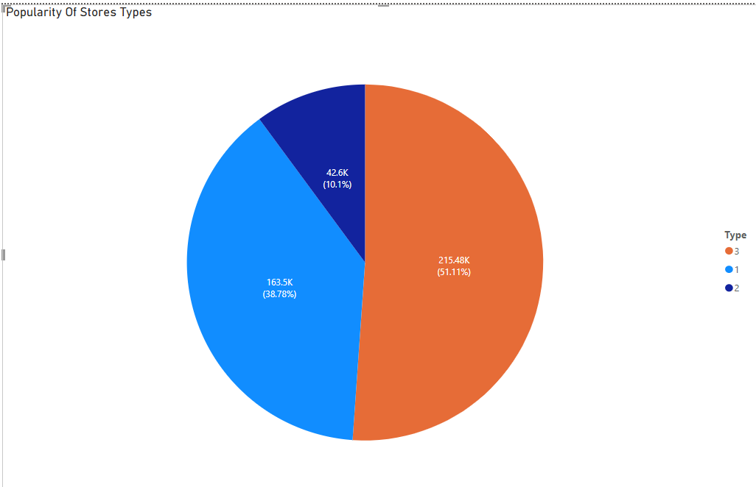
Power Bi Visulization

Slide 12
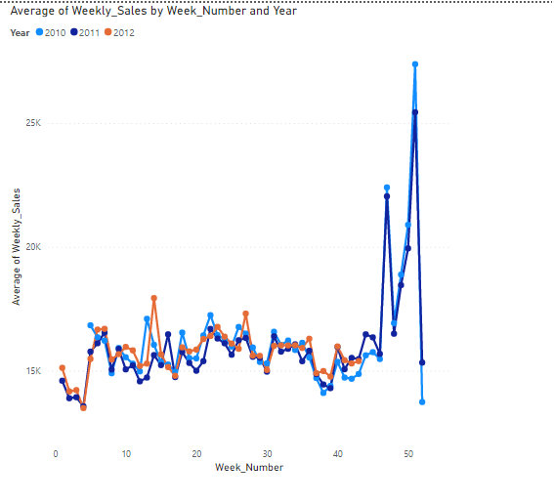
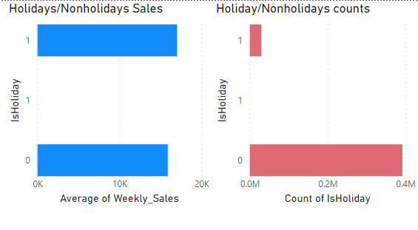

Slide 13
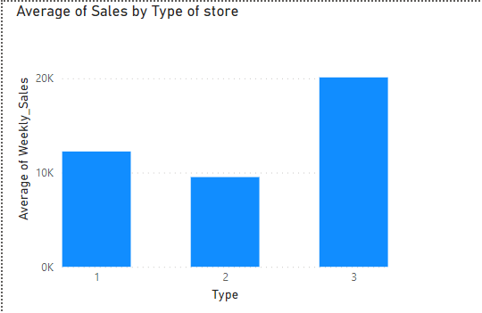
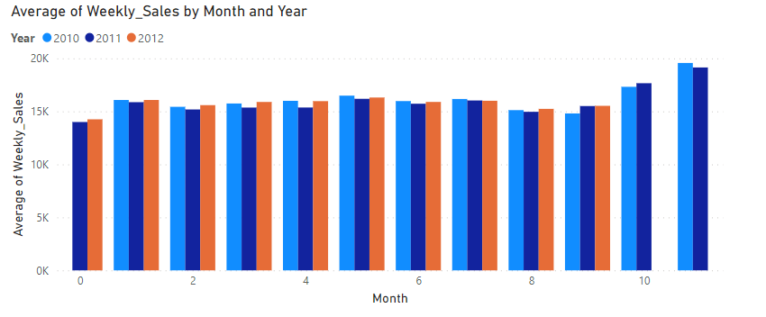

Slide 14
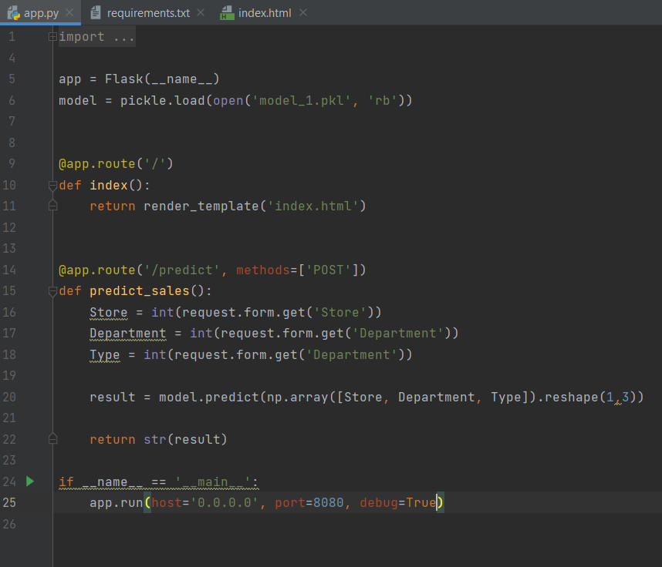
App.py

Slide 15
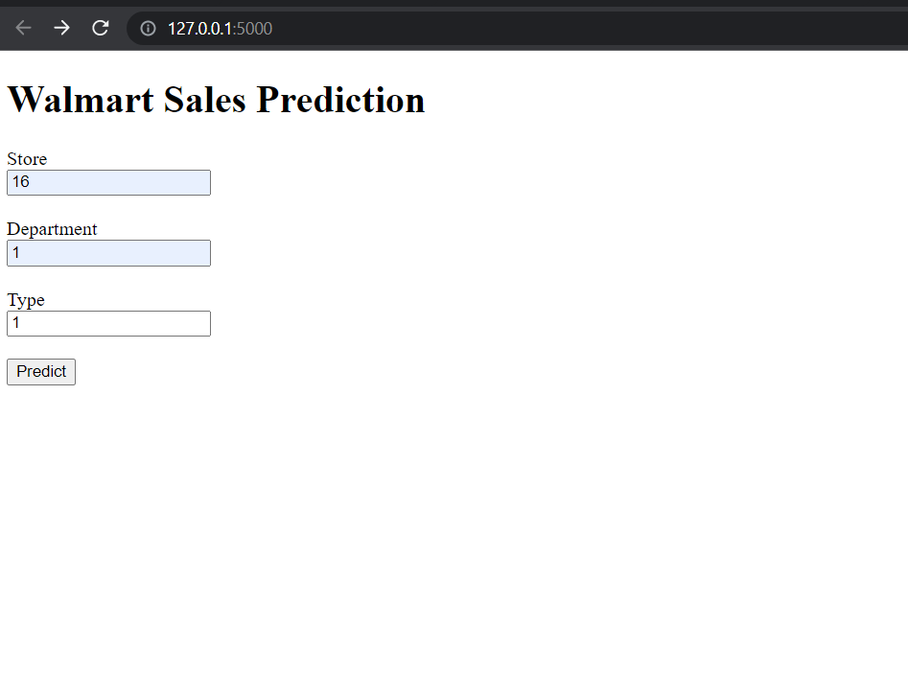
User Interface

Slide 16
THANK YOU!

